Slide 1

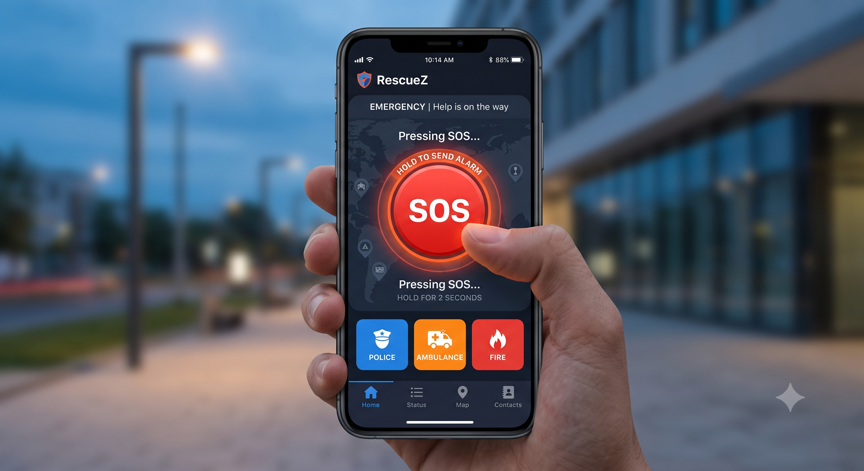
HACKATHON PROTOTYPE PITCH
Web Platform
RescuEZ
Emergency Assistance & Rescue Coordination Web Platform
LIVE PROTOTYPE DEMO
https://rescuez.onrender.com/user.html
TEAM RESCUEZ
S. Rafia Muhammadi
J. Athif Ali Khan

Slide 2
SLIDE 1 — PROBLEM STATEMENT
RescuEZ Pitch
Emergency Response Delays
People may struggle to communicate during emergencies.
Emergency information can be incomplete or unstructured.
Exact location is critical for assistance.
Responders need organized information to understand and prioritize incidents.
Coordination between victims and responders can be difficult.
“Every second matters when someone needs help.”
Core Challenge

Slide 3
SLIDE 2 — PROPOSED SOLUTION
RescuEZ — Smart Emergency Assistance Platform
A web-based emergency assistance platform bridging victims and coordination channels.
MAIN PROTOTYPE FEATURES:
SOS Emergency Request
Emergency Type & Severity Selection
Location / GPS Information
Number of People Affected
Immediate Assistance Requirements
Command-Center Coordination
Responder / Volunteer Registration
(Enables local assistance signups)
SIMPLE VISUAL WORKFLOW
Emergency
SOS Request
Location & Details
Command Center
Coordinated Assistance
Prototype Scope: Focuses on reporting and coordination layer; does not directly dispatch real police, ambulances, or municipal rescue teams.

Slide 4




SLIDE 3 — TARGET USERS
Who Is RescuEZ For?
Victims / Users
Responders & Volunteers
Command Centers
Institutions
People who need emergency assistance.
People who can provide or coordinate assistance.
Authorized organizations managing emergency requests.
Colleges, workplaces, communities and organizations requiring emergency coordination.
Direct Alert Access
Registered Support
Central Coordination
Safety Infrastructure
A unified interface serving victims, volunteers, management teams, and institutions.

Slide 5
SLIDE 4 — TECHNICAL APPROACH
How RescuEZ Works
SYSTEM ARCHITECTURE:
User Interface
Emergency Request
Location + Details
Backend / Database
Command Center
Responder Coord.
TECHNOLOGIES USED IN THE PROTOTYPE:
HTML
CSS
JavaScript
Web-based interface
GPS/location services
Map/location functionality
Backend / API
Cloud deployment

Slide 6
SLIDE 5 — MARKET & BUSINESS POTENTIAL
From Prototype to Real-World Impact
Potential Users / Customers:
Possible Business Models:
Educational institutions
Institutional subscription
Companies and workplaces
Customized emergency-management solutions
Residential communities
Partnerships with organizations
NGOs and volunteer organizations
Enterprise safety solutions
Disaster-management organizations
“A scalable platform for structured emergency reporting and coordination.”

Slide 7
SLIDE 6 — SCALABILITY & FUTURE
Scaling RescuEZ
HOW THE PROTOTYPE CAN EVOLVE:
Android/iOS mobile application
Real-time emergency tracking
Advanced command dashboard
Push/SMS notifications
Multi-language support
AI-assisted classification
Hospital & responder integration
Emergency analytics
VISUAL PROGRESSION:
Prototype
Mobile Platform
Responder Network
Connected Emergency Ecosystem

Slide 8
SLIDE 7 — IF WE HAD MORE TIME
What Would We Build Next?
1.
Real-Time Responder Dashboard:
Manage and track emergency requests.
2.
Mobile Application:
Faster SOS access and location sharing.
3.
AI Assistance:
Help classify and prioritize incoming emergency requests.
4.
SMS/Offline Emergency Mode:
Improve reliability when internet connectivity is unavailable.
5.
Verified Emergency Partnerships:
Connect the platform with authorized response organizations.
“RescuEZ — Connecting emergency information with coordinated assistance.”
TEAM RESCUEZ
S. Rafia Muhammadi | J. Athif Ali Khan

